Slide 1


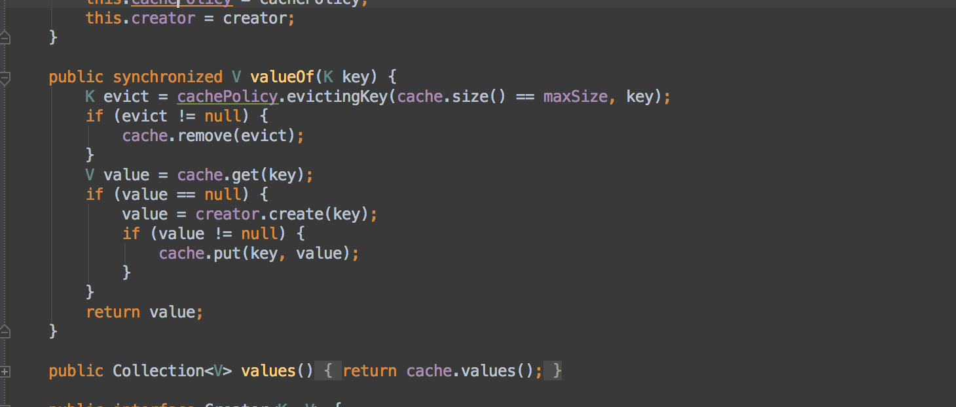

Functional Programming
Extension Methods, Lambda Expressions, LINQ
Functional Programming
SoftUni Team
Technical Trainers
Software University
http://softuni.bg

Slide 2

Table of Contents
Functional Programming Paradigms
Extension Methods
Anonymous Types
Lambda Expressions
LINQ Queries

Slide 3
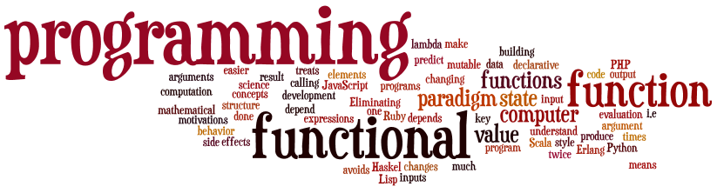
Functional Programming
Paradigms, Concepts, Languages

Slide 4
What is Functional Programming?
Functional programming is a programming paradigm
Uses computations of mathematical functions to build programs
Declarative programming paradigm (not imperative)
Uses first-class functions, higher-order functions, lambda functions, anonymous functions, closures, etc.
Pure-functional languages (no variables and loops): Haskell
Almost-functional: Clojure, Lisp, Scheme, Scala, F#, JavaScript
Imperative with functional support: C#, Python, Ruby, PHP, Java
Non-functional: C, Pascal, the old versions of C#, Java, C++, PHP

Slide 5
Functions in Functional Programming
First-class functions
Variables holding functions as a value (delegates in C#)
Higher-order functions
Functions taking other functions as input (LINQ extensions in C#)
Оr returning a function as output
Closures
Nested functions hold (close) persistent state in their outer scope
Allow creating objects with private fields in functional languages

Slide 6
Functions in Functional Programming (2)
Anonymous functions
Functions without names (delegates in C#), e.g.
Lambda functions
Anonymous functions that take parameters and return value
Example:
var f = function(a, b) { return a+b; }
f(3, 5) → 8
(x, y) => x * x + y * y

Slide 7
Functional vs. Imperative Programming
Functional programming
Program by invoking sequences of functions
Example in JavaScript:
Imperative programming
Describe the algorithm by programming constructs
Example in JavaScript:
var arr = [2, 3, 1, 8, 5];
arr.forEach(
function(element, index) {
console.log(element);
}
);
var arr = [2, 3, 1, 8, 5];
for (var i in arr) {
console.log(arr[i]);
}

Slide 8

Extension Methods

Slide 9

Extension Methods
Once a type is defined and compiled into an assembly its definition is, more or less, final
The only way to update, remove or add new members is to recode and recompile the code
Extension methods allow existing compiled types to gain new functionality
Without recompilation
Without touching the original assembly

Slide 10
Defining Extension Methods
Extension methods
Defined in a static class
Defined as static
Use the this keyword before its first argument to specify the class to be extended
Extension methods are "attached" to the extended class
Can also be called statically through the defining static class

Slide 11
Extension Methods – Examples
public static class Extensions
{
public static int WordCount(this string str)
{
return str.Split(new char[] { ' ', '.', '?' },
StringSplitOptions.RemoveEmptyEntries).Length;
}
}
…
static void Main()
{
string s = "Hello Extension Methods";
int i = s.WordCount();
Console.WriteLine(i);
}

Slide 12
Extension Methods – Examples (2)
public static void IncreaseWidth(this IList<int> list, int amount)
{
for (int i = 0; i < list.Count; i++)
{
list[i] += amount;
}
}
…
static void Main()
{
List<int> ints =
new List<int> { 1, 2, 3, 4, 5 };
ints.IncreaseWidth(5); // 6, 7, 8, 9, 10
}

Slide 13

Extension Methods
Live Demo

Slide 14

Exercises in Class

Slide 15

Anonymous Types

Slide 16
Anonymous Types
Anonymous types
Encapsulate a set of read-only properties and their value into a single object
No need to explicitly define a type first
To define an anonymous type
Use of the new var keyword in conjunction with the object initialization syntax
var point = new { X = 3, Y = 5 };

Slide 17
Anonymous Types – Example
// Use an anonymous type representing a car
var myCar =
new { Color = "Red", Brand = "BMW", Speed = 180 };
Console.WriteLine("My car is a {0} {1}.",
myCar.Color, myCar.Brand);
At compile time, the C# compiler will autogenerate an uniquely named class
The class name is not visible from C#
Using implicit typing (var keyword) is mandatory

Slide 18
Anonymous Types – Properties
Anonymous types are reference types directly derived from System.Object
Have overridden version of Equals(), GetHashCode(), and ToString()
Do not have == and != operators overloaded
var p = new { X = 3, Y = 5 };
var q = new { X = 3, Y = 5 };
Console.WriteLine(p == q); // false
Console.WriteLine(p.Equals(q)); // true

Slide 19
Arrays of Anonymous Types
You can define and use arrays of anonymous types through the following syntax:
var arr = new[] {
new { X = 3, Y = 5 },
new { X = 1, Y = 2 },
new { X = 0, Y = 7 } };
foreach (var item in arr)
{
Console.WriteLine("({0}, {1})",
item.X, item.Y);
}

Slide 20

Anonymous Types
Live Demo

Slide 21
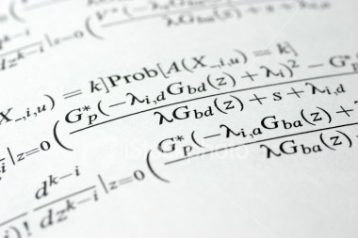
Lambda Expressions

Slide 22
Lambda Expressions
A lambda expression is an anonymous function containing expressions and statements
Used to create delegates or expression tree types
Lambda expressions
Use the lambda operator =>
Read as "goes to"
The left side specifies the input parameters
The right side holds the expression or statement

Slide 23
Lambda Expressions – Examples
Usually used with collection extension methods like FindAll() and RemoveAll()
List<int> list = new List<int>() { 1, 2, 3, 4 };
List<int> evenNumbers = list.FindAll(x => (x % 2) == 0);
foreach (var num in evenNumbers)
{
Console.Write("{0} ", num);
}
Console.WriteLine();
// 2 4
list.RemoveAll(x => x > 3); // 1 2 3

Slide 24
Sorting with Lambda Expression
var pets = new Pet[]
{
new Pet { Name="Sharo", Age=8 },
new Pet { Name="Rex", Age=4 },
new Pet { Name="Strela", Age=1 },
new Pet { Name="Bora", Age=3 }
};
var sortedPets = pets.OrderBy(pet => pet.Age);
foreach (Pet pet in sortedPets)
{
Console.WriteLine("{0} -> {1}", pet.Name, pet.Age);
}

Slide 25
Lambda Code Expressions
Lambda code expressions:
List<int> list = new List<int>() { 20, 1, 4, 8, 9, 44 };
// Process each argument with code statements
List<int> evenNumbers = list.FindAll((i) =>
{
Console.WriteLine("value of i is: {0}", i);
return (i % 2) == 0;
});
Console.WriteLine("Here are your even numbers:");
foreach (int even in evenNumbers)
Console.Write("{0}\t", even);

Slide 26
Predicates
Predicates are predefined delegates with the following signature
Define a way to check if an object meets some Boolean criteria
Similar to Func<T, bool>
Used by many methods of Array and List<T> to search for an element
For example List<T>.FindAll(…) retrieves all elements meeting the criteria
public delegate bool Predicate<T>(T obj)

Slide 27
Predicates – Example
List<string> towns = new List<string>()
{ "Sofia", "Plovdiv", "Varna", "Sopot", "Silistra" };
List<string> townsWithS =
towns.FindAll(delegate(string town)
{
return town.StartsWith("S");
});
// A short form of the above (with lambda expression)
List<string> townsWithS =
towns.FindAll((town) => town.StartsWith("S"));
foreach (string town in townsWithS)
{
Console.WriteLine(town);
}

Slide 28

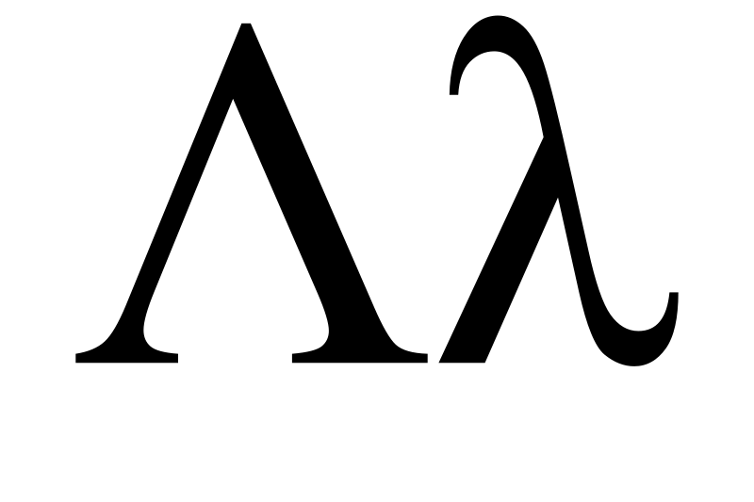
Lambda Expressions
Live Demo

Slide 29

Action<T> and Func<T>
Live Demo

Slide 30



LINQ and Query Keywords
LINQ

Slide 31
LINQ Building Blocks (2)
LINQ is a set of extensions to .NET Framework
Encompasses language-integrated query, set, and transform operations
Consistent manner to obtain and manipulate "data" in the broad sense of the term
Query expressions can be defined directly within the C# programming language
Used to interact with numerous data types
Converted to expression trees at compile time and evaluated at runtime (when invoked, e.g. by foreach)

Slide 32





LINQ to *
C#
VB.NET
Others …
.NET Language-Integrated Query (LINQ)
LINQ enabled data sources
LINQ enabled ADO.NET
LINQ to Objects
LINQ to DataSets
LINQ
to SQL
LINQ to
Entities
LINQ
to XML
<book>
<title/>
<author/>
<price/>
</book>
Objects
Relational Data
XML

Slide 33
LINQ and Query Keywords
Language Integrated Query (LINQ) query keywords
from – specifies data source and range variable
where – filters source elements
select – specifies the type and shape that the elements in the returned sequence
group – groups query results according to a specified key value
orderby – sorts query results in ascending or descending order

Slide 34

Query Keywords – Examples
select, from and where clauses:
int[] numbers = { 5, 4, 1, 3, 9, 8, 6, 7, 2, 0 };
var querySmallNums =
from num in numbers
where num < 5
select num;
foreach (var num in querySmallNums)
{
Console.Write(num.ToString() + " ");
}
// The result is 4 1 3 2 0

Slide 35

Query Keywords – Examples (2)
Nested queries:
string[] towns =
{ "Sofia", "Varna", "Pleven", "Ruse", "Bourgas" };
var townPairs =
from t1 in towns
from t2 in towns
select new { T1 = t1, T2 = t2 };
foreach (var townPair in townPairs)
{
Console.WriteLine("({0}, {1})",
townPair.T1, townPair.T2);
}

Slide 36

Query Keywords – Examples (3)
Sorting with оrderby:
string[] fruits =
{ "cherry", "apple", "blueberry", "banana" };
// Sort in ascending sort
var fruitsAscending =
from fruit in fruits
orderby fruit
select fruit;
foreach (string fruit in fruitsAscending)
{
Console.WriteLine(fruit);
}

Slide 37
Standard Query Operators – Example
string[] games = { "Morrowind", "BioShock", "Half Life",
"The Darkness", "Daxter", "System Shock 2" };
// Build a query expression using extension methods
// granted to the Array via the Enumerable type
var subset = games.Where(game => game.Length > 6).
OrderBy(game => game).Select(game => game);
foreach (var game in subset)
Console.WriteLine(game);
Console.WriteLine();
var subset =
from g in games
where g.Length > 6
orderby g
select g;

Slide 38
Counting the Words in a String – Example
string text = "Historically, the world of data …";
…
string searchTerm = "data";
string[] source = text.Split(
new char[] { '.', '?', '!', ' ', ';', ':', ',' },
StringSplitOptions.RemoveEmptyEntries);
// Use ToLower() to match both "data" and "Data"
var matchQuery =
from word in source
where word.ToLower() == searchTerm.ToLower()
select word;
int wordCount =
matchQuery.Count();
int wordCount = source.Where(
w => w.toLower() ==
searchTerm.ToLower()).Count();

Slide 39
Querying Arrays
Any kind of arrays can be used with LINQ
Can even be an untyped array of objects
Queries can be applied to arrays of custom objects
Example:
var titles =
from b in books
where b.Title.Contains("Action")
select b.Title;
Book[] books = {
new Book { Title="LINQ in Action" },
new Book { Title="LINQ for Fun" },
new Book { Title="Extreme LINQ" } };
var titles = books
.Where(book => book.Title.Contains("Action"))
.Select(book => book.Title);

Slide 40
Querying Generic Lists
The previous example can be adapted to work with a generic list
List<T>, LinkedList<T>, Queue<T>, Stack<T>, HashSet<T>, etc.
List<Book> books = new List<Book>() {
new Book { Title="LINQ in Action" },
new Book { Title="LINQ for Fun" },
new Book { Title="Extreme LINQ" } };
var titles = books
.Where(book => book.Title.Contains("Action"))
.Select(book => book.Title);

Slide 41
Querying Strings
Although System.String may not be perceived as a collection at first sight
It is actually a collection, because it implements IEnumerable<char>
String objects can be queried with LINQ to Objects, like any other collection
var count = "Non-letter characters in this string: 8"
.Where(c => !char.IsLetter(c))
.Count();
Console.WriteLine(count);
// The result is: 8
var count =
(from c in "Non-letter…"
where !char.IsLetter(c)
select c).Count();

Slide 42
LINQ: Operations
Where()
Searches by given condition
First() / FirstOrDefault()
Gets the first matched element
Last() / LastOrDefault()
Gets the last matched element
Select() / Cast()
Makes projection (conversion) to another type
OrderBy() / ThenBy() / OrderByDescending()
Orders a collection

Slide 43
LINQ: Operations (2)
Any()
Checks if any element matches a condition
All()
Checks if all elements match a condition
ToArray()/ToList()/AsEnumerable()
Converts the collection type
Reverse()
Reverses a collection

Slide 44
LINQ Aggregation Methods
Average()
Calculates the average value of a collection
Count()
Counts the elements in a collection
Max()
Determines the maximum value in a collection
Sum()
Sums the values in a collection

Slide 45
LINQ Aggregation Methods – Examples
Count(<condition>)
Max()
double[] temperatures =
{28.0, 19.5, 32.3, 33.6, 26.5, 29.7};
int highTempCount = temperatures.Count(p => p > 30);
Console.WriteLine(highTempCount);
// The result is: 2
var highTemp =
(from p in temperatures
where p > 30
select p).Count();
double[] temperatures =
{28.0, 19.5, 32.3, 33.6, 26.5, 29.7};
double maxTemp = temperatures.Max();
Console.WriteLine(maxTemp);
// The result is: 33.6
var highTemp =
(from p in temperatures
select p).Max();

Slide 46

LINQ Query Keywords
LINQ
Live Demo

Slide 47
Exercises in Class

Slide 48
Parallel Queries
AsParallel() – enables the use of parallel threads
Called right before the query execution
Improves the performance when dealing with heavy operations
Can be slower than non-parallel on small number of elements
const int m = 1000;
int[] array = Enumerable.Range(0, 1000).ToArray();
int sum = 0;
for (int i = 0; i < m; i++)
{
sum = array.AsParallel().Sum();
}

Slide 49
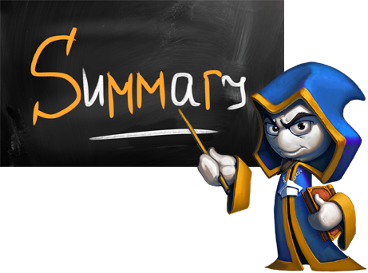
Summary
Extension methods extend the functionality of existing types
Anonymous types are type-less objects with a set of read-only properties
Lambda expressions are anonymous functions used with delegates
LINQ is a set of extension methods for working
with collections

Slide 50









Functional Programming
http://softuni.org/courses

Slide 51

License
This course (slides, examples, demos, videos, homework, etc.) is licensed under the "Creative Commons Attribution-NonCommercial-ShareAlike 4.0 International" license
Attribution: this work may contain portions from
"Fundamentals of Computer Programming with C#" book by Svetlin Nakov & Co. under CC-BY-SA license
"OOP" course by Telerik Academy under CC-BY-NC-SA license

Slide 52






Free Trainings @ Software University
Software University Foundation – softuni.org
Software University – High-Quality Education, Profession and Job for Software Developers
softuni.bg
Software University @ Facebook
facebook.com/SoftwareUniversity
Software University @ YouTube
youtube.com/SoftwareUniversity
Software University Forums – forum.softuni.bg

